Slide 1
Linked List
Israt Jahan Rinky
Lecturer,
Dept. of CSE, Varendra University.

Slide 2
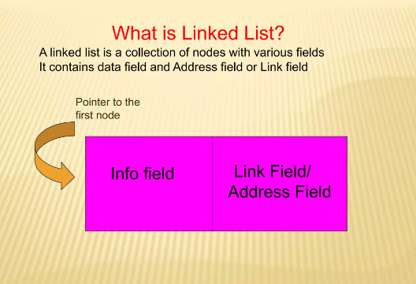

Slide 3
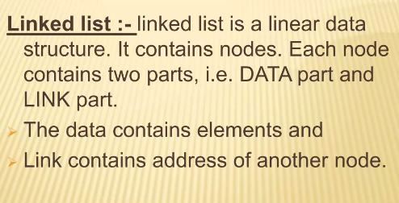

Slide 4
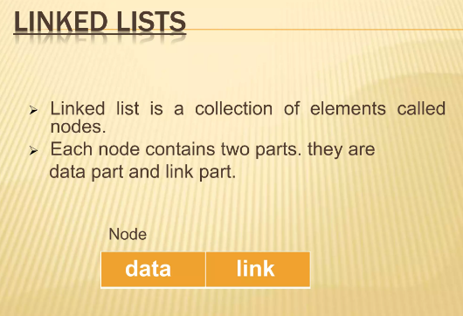

Slide 5
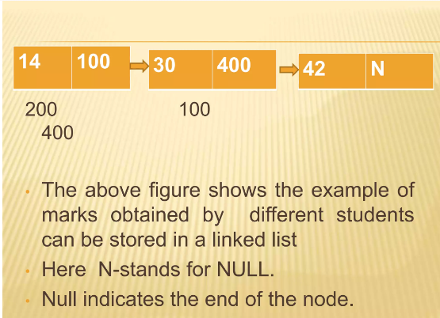

Slide 6
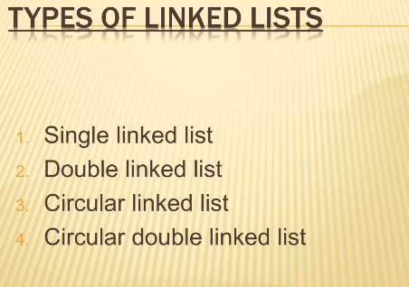

Slide 7
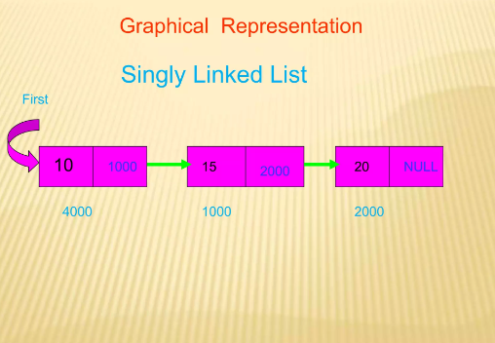

Slide 8
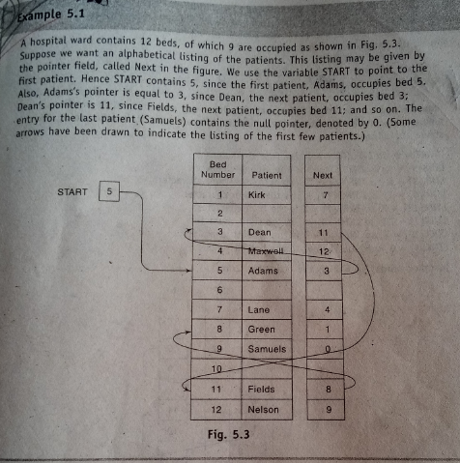

Slide 9
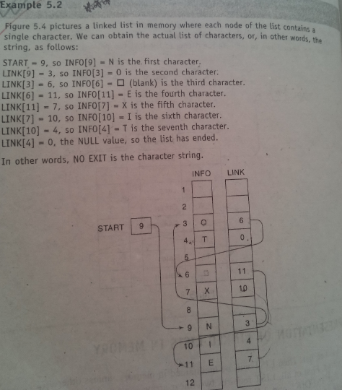

Slide 10
Traversing a Linked List
Start
1
AA | 2
BB | 3
CC | 4
DD | X
INFO[1]=AA | LINK[1]=2
INFO[2]=BB | LINK[2]=3
INFO[3]=CC | LINK[3]=4
INFO[4]=DD | LINK[4]=X
INFO | LINK
LINK[PTR]
INFO[PTR]

Slide 11
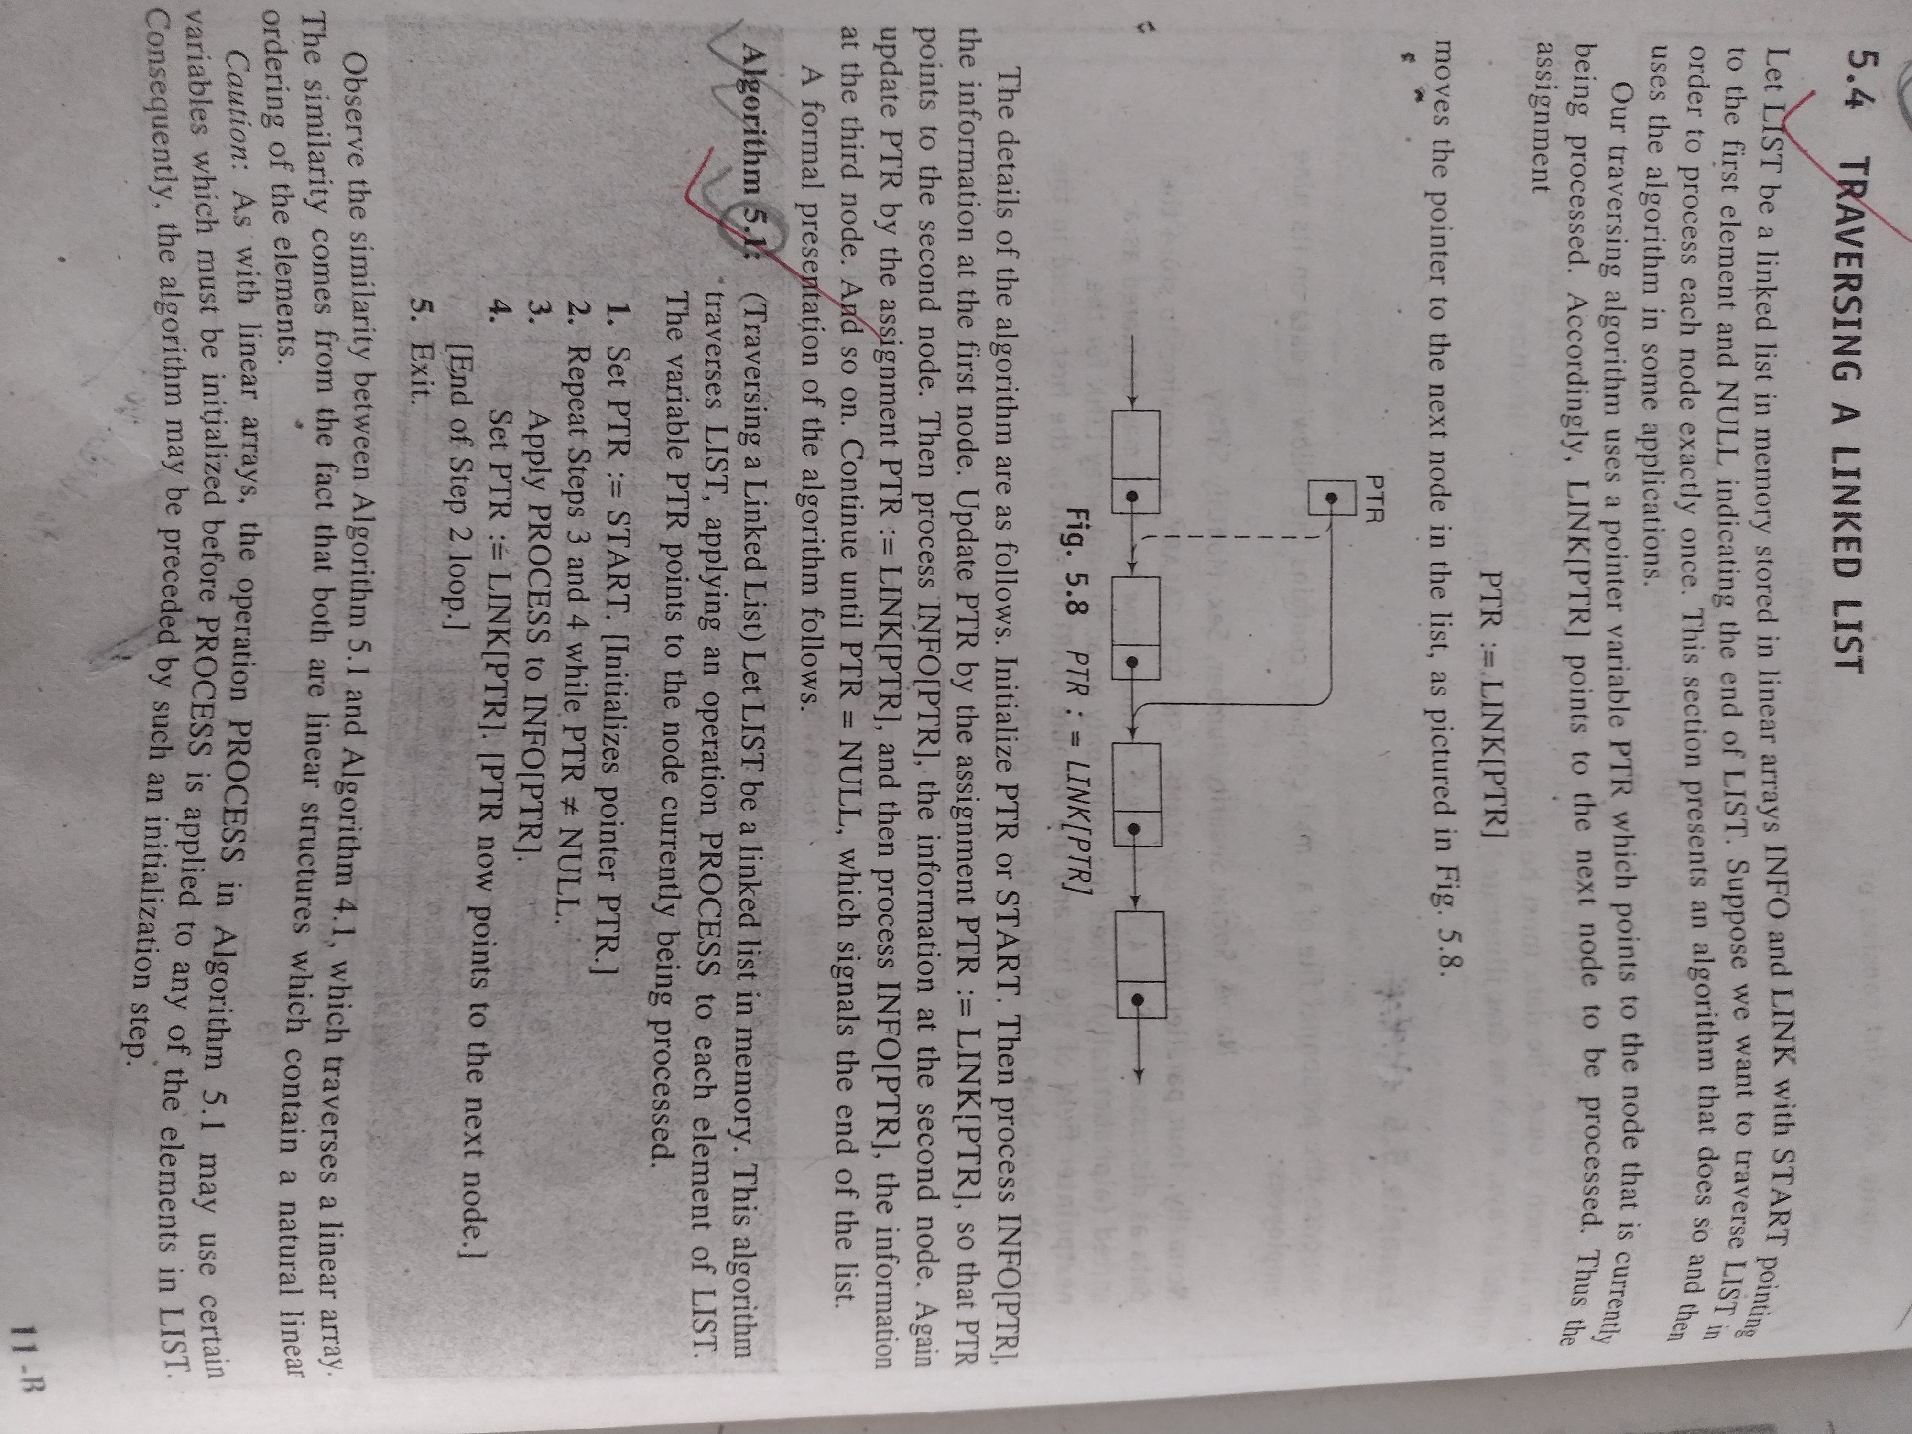

Slide 12
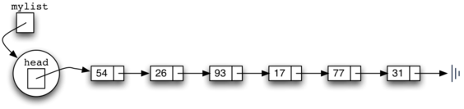
Unsorted linked list

Slide 13
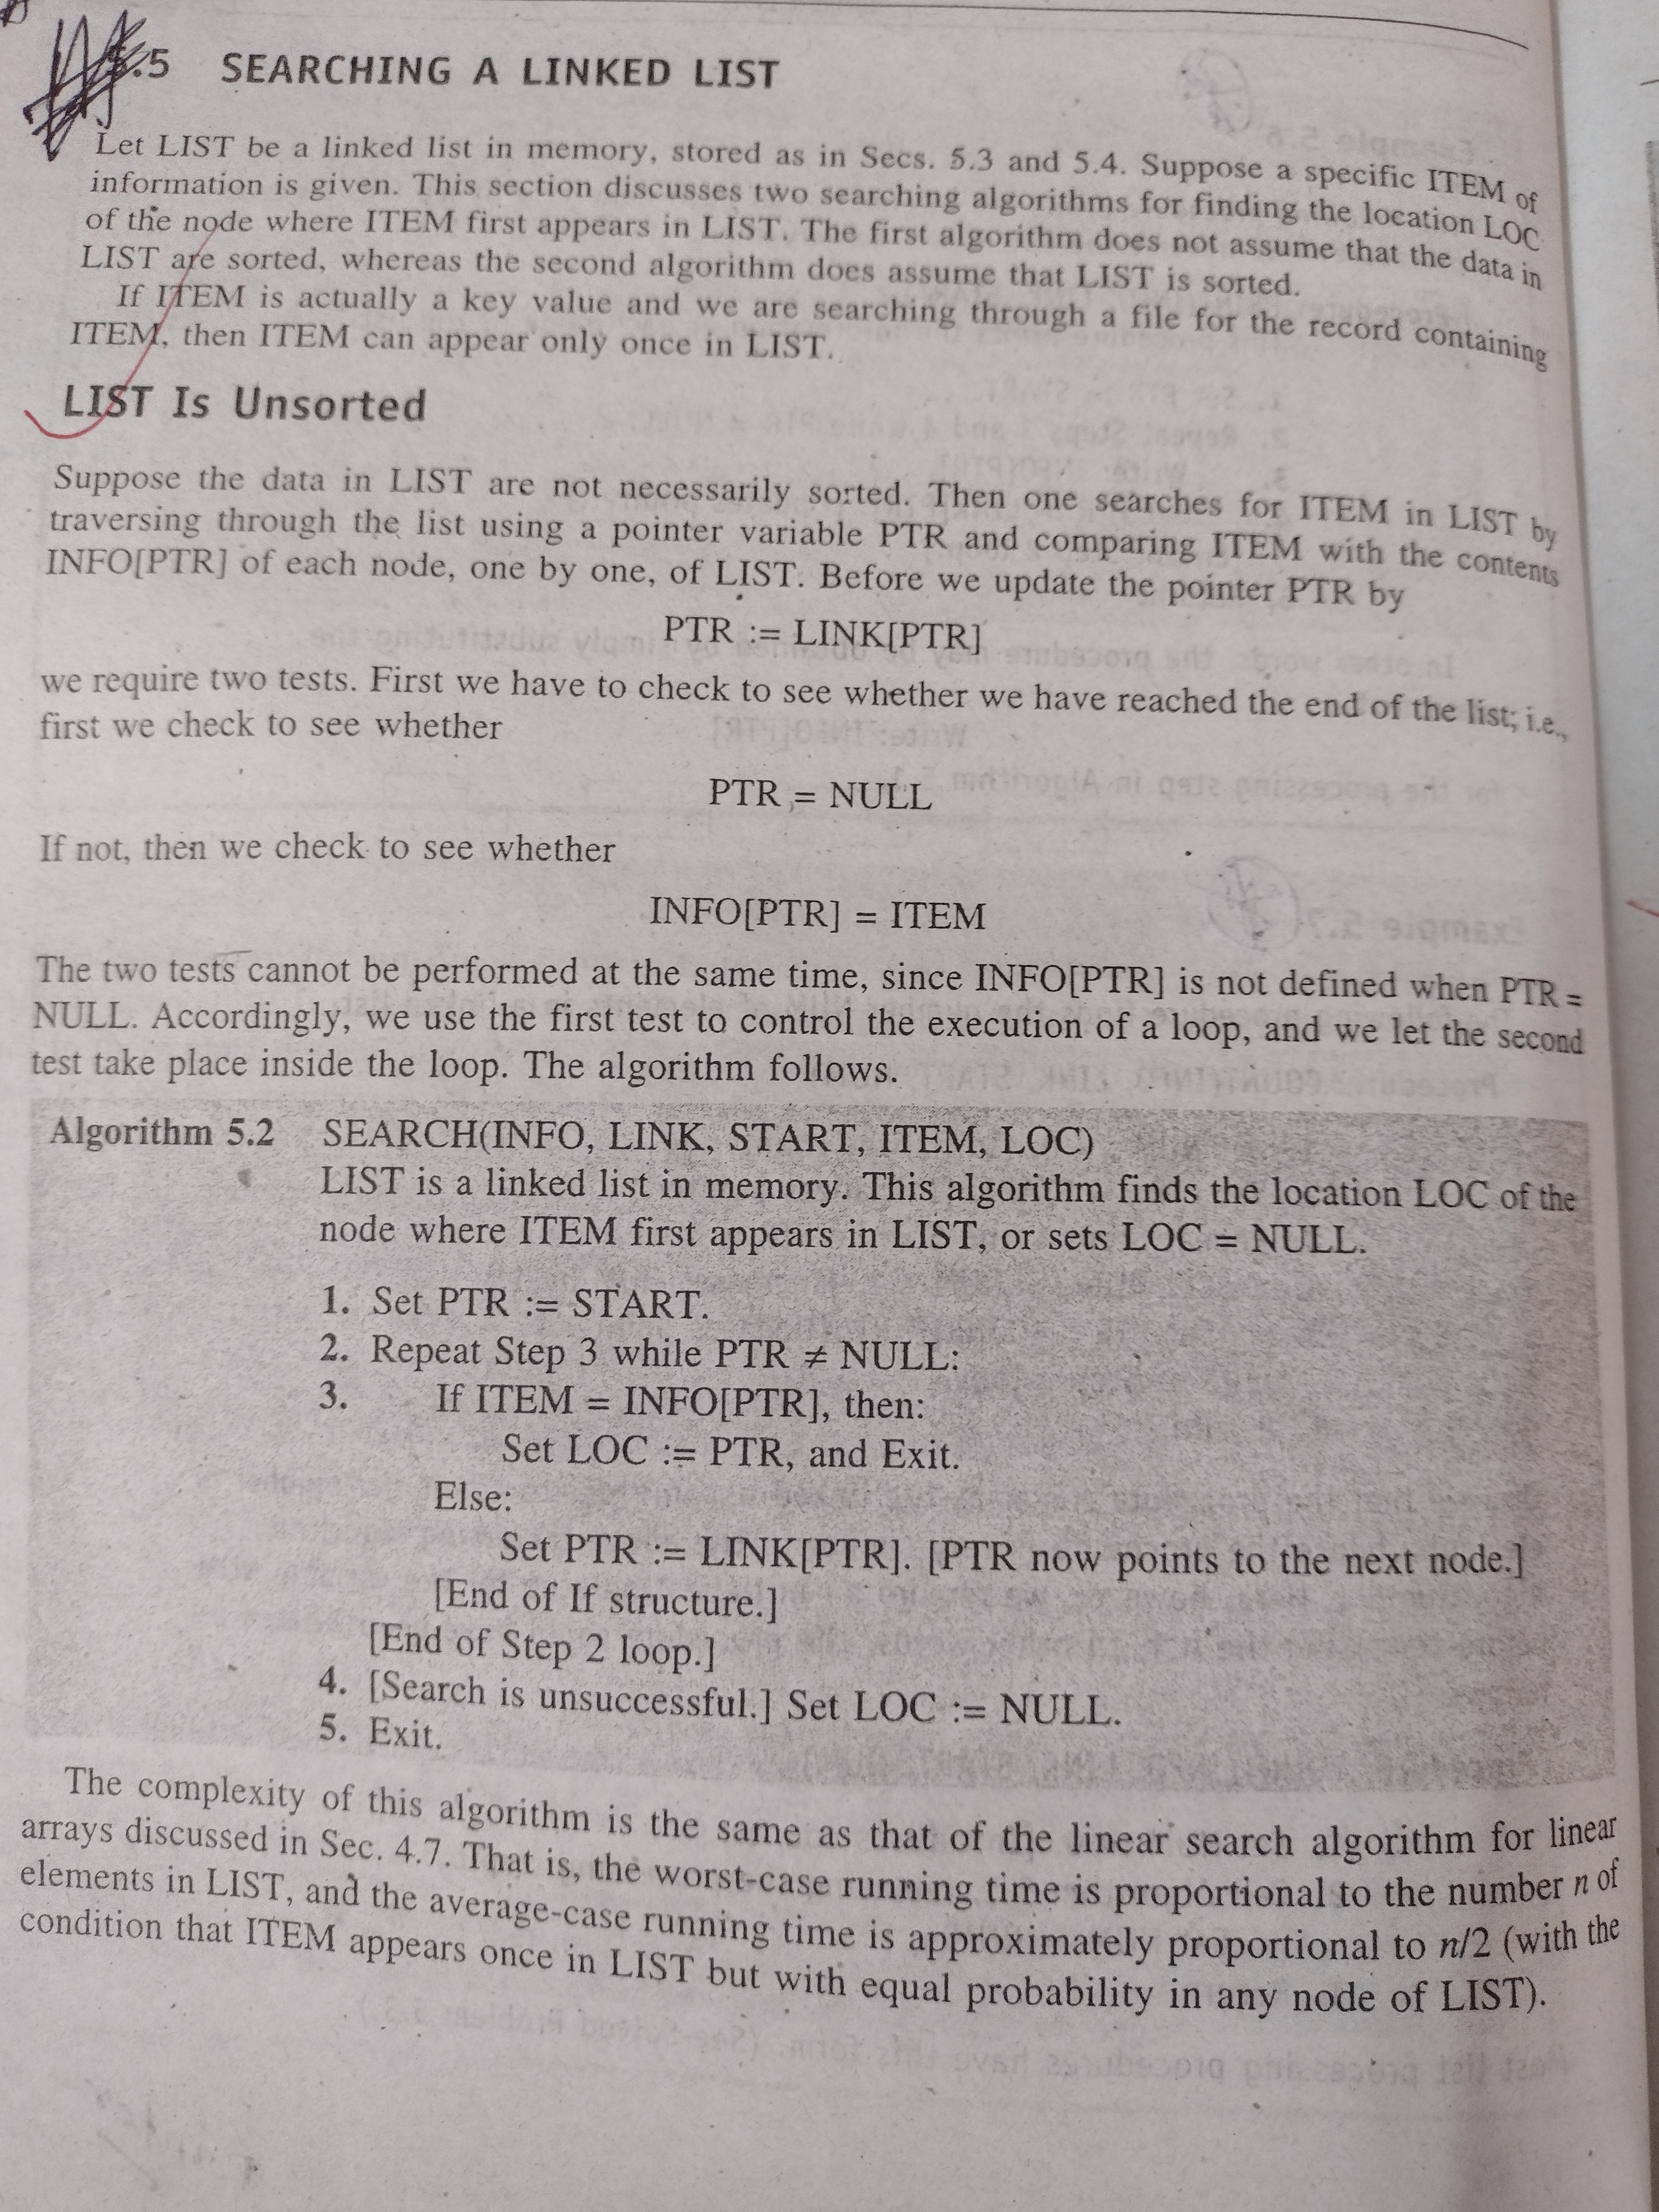

Slide 14
Linked list: Searching on unsorted linked list
Algo ll_unsorted_search(start,item)
{
ptr=start
while(ptr ≠ null and ptr info ≠item)
{
ptr = ptr next
}
if(ptr == null)
{
print “unsuccessful searching”;
}
else{
print “Found at”, ptr
}
}

Slide 15
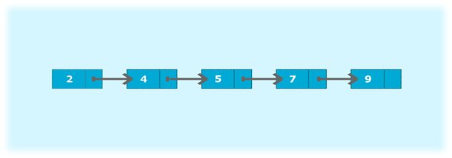
Sorted linked list

Slide 16
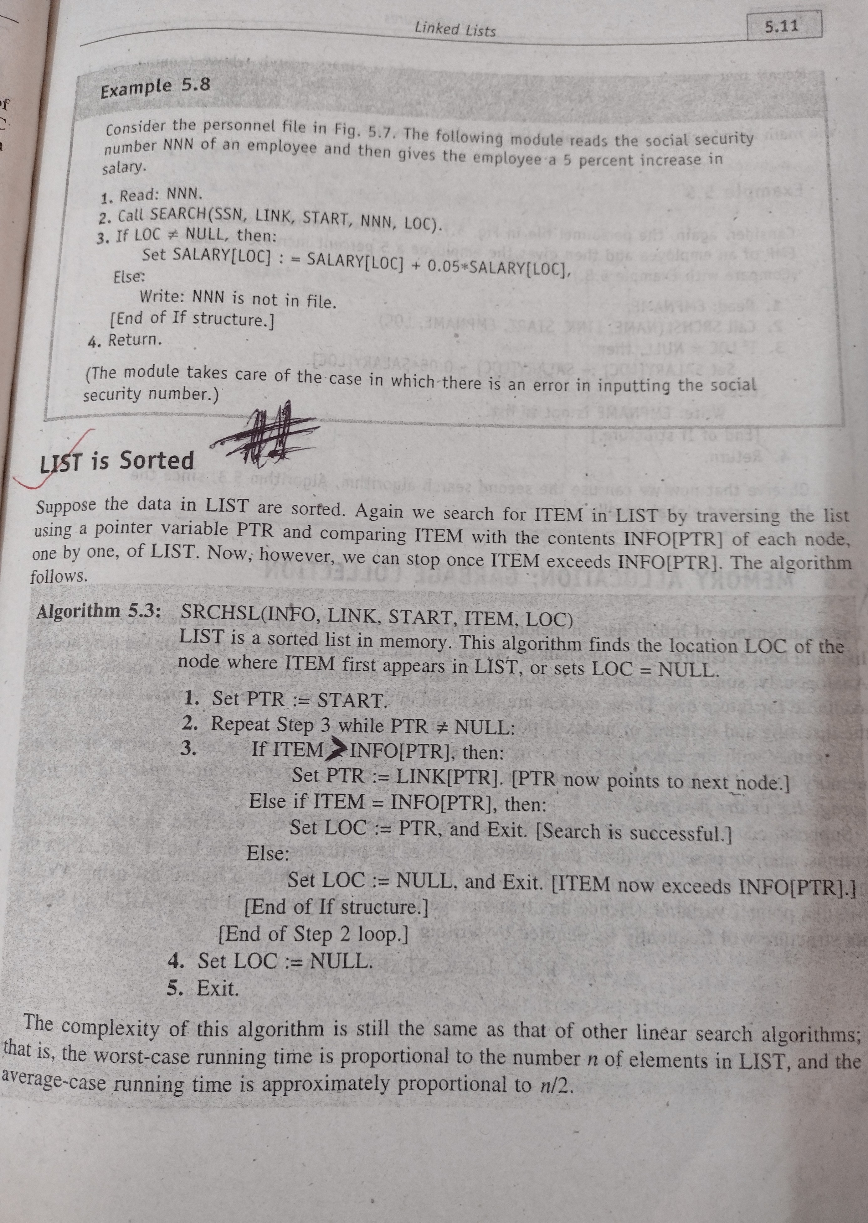

Slide 17
Insertion Algorithms in Linked List
Inserts a node at the beginning of the list.
Inserts a node after the node with a given location
Inserts a node into a sorted list.

Slide 18
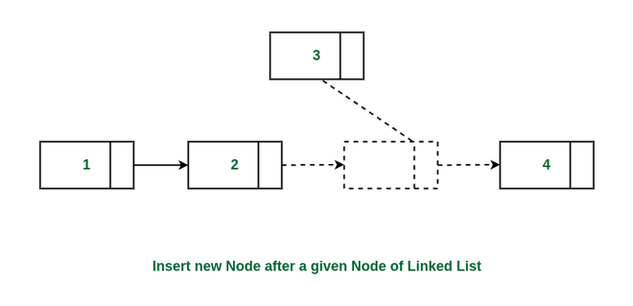
Inserting after given node

Slide 19
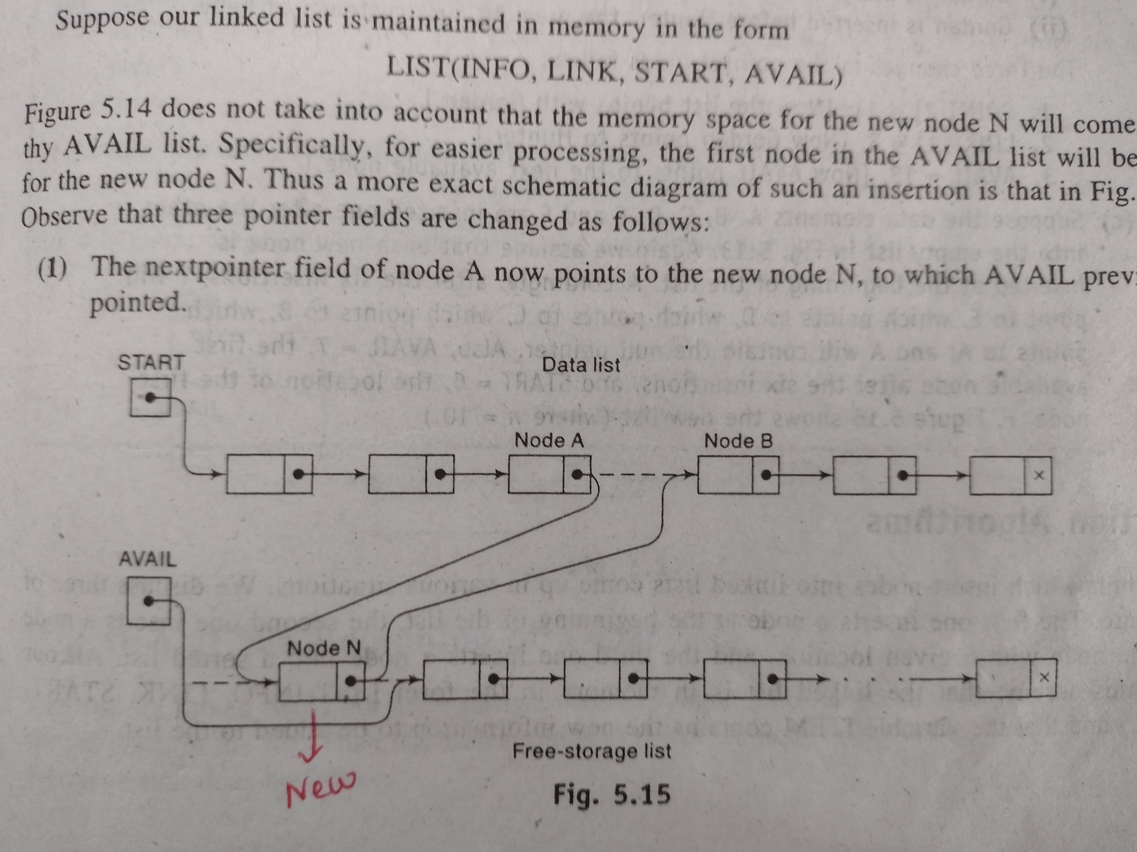

Slide 20
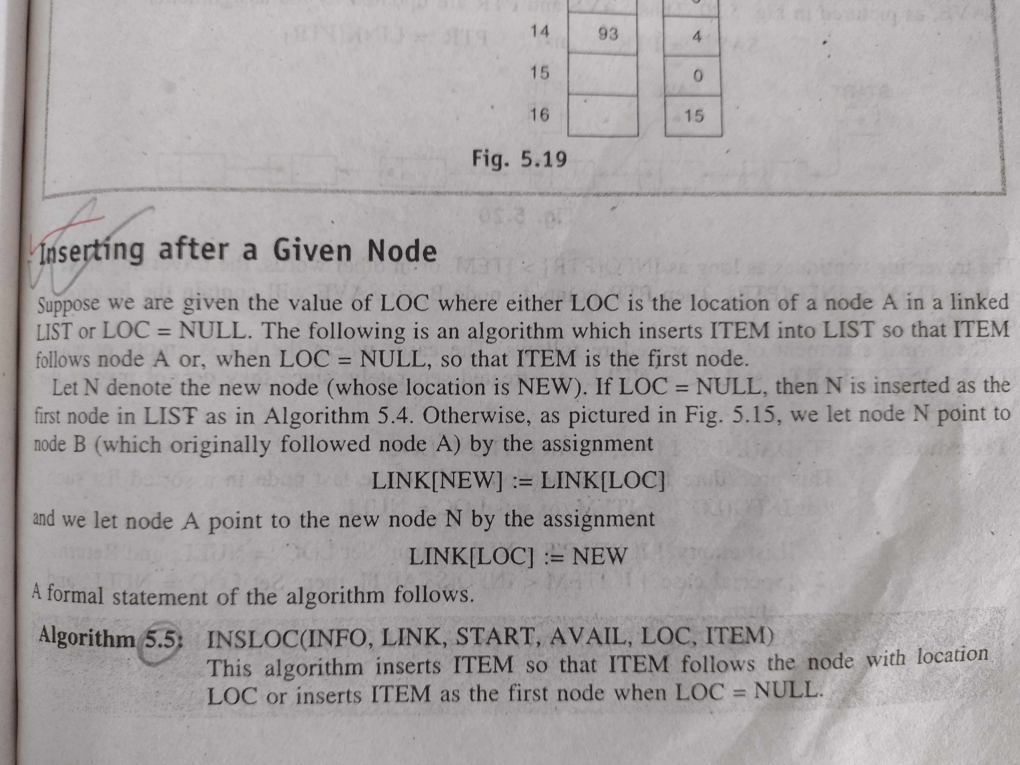
Inserting after a given node

Slide 21
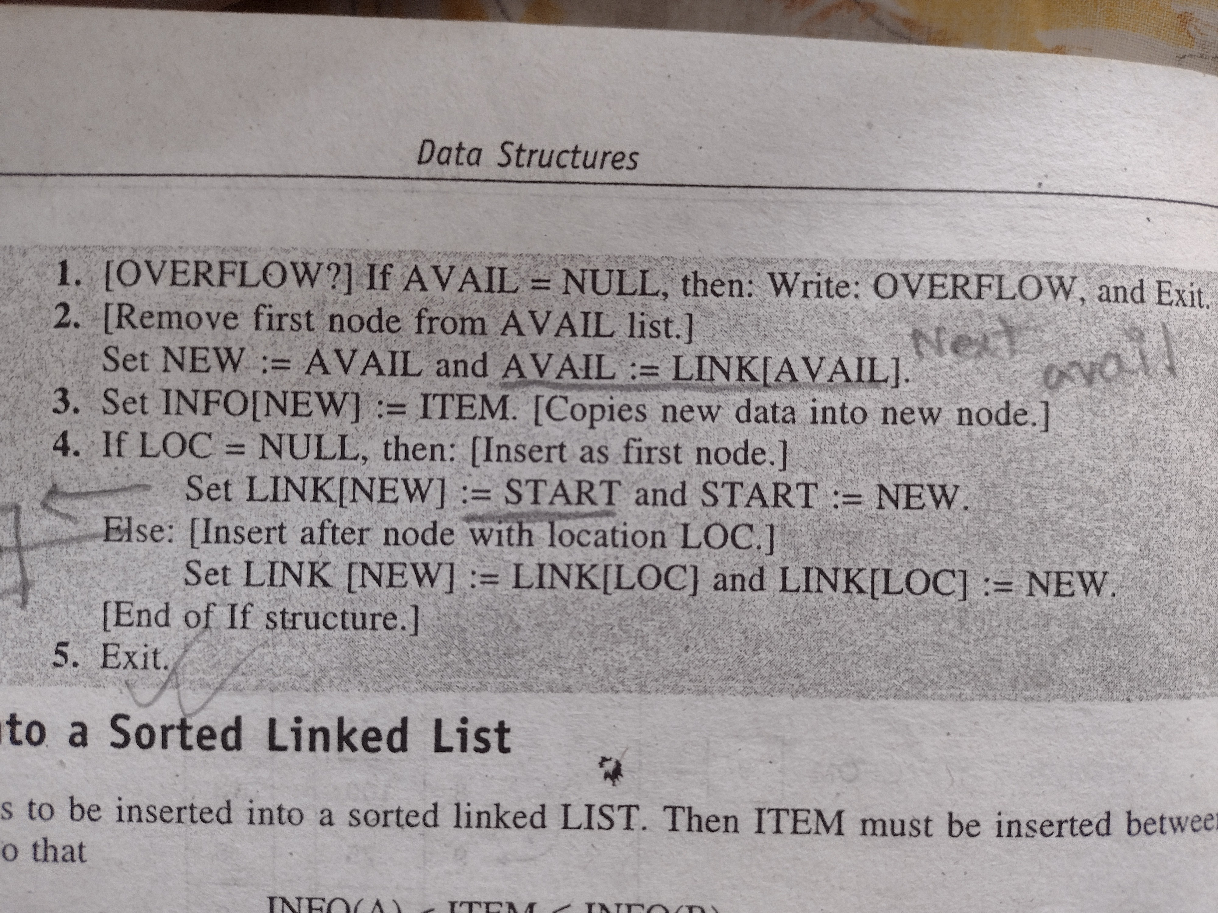

Slide 22
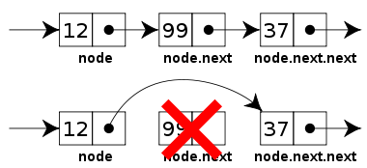
Deletion from a Linked List

Slide 23
